Slide 1
OWNCLOUD Setup presentation by dynamic dudes

Slide 2
Description of project
We create a web app where anyone can store and fetch their data which is connected locally with us just like LAN connectivity. We can use this product to store our confidential papers which we don't want to store in public storage. Through this, we create something like our personal drive which can only accessible by our LAN users. It's not only beneficial for the education field but nearly every field can use this type of product in our local environment. Like medical field can use this to store our patient's data and because it's locally available so we fetch the data very rapidly as compared to the internet.
We use docker to create this kind of setup as because we are in the agile world. we need to deploy as soon as possible. With the use of docker we can deploy our setup in just some seconds.
# Pre-requisite for setup this in our own local setup
1. We need a docker installed
2. We need docker-compose software installed

Slide 3
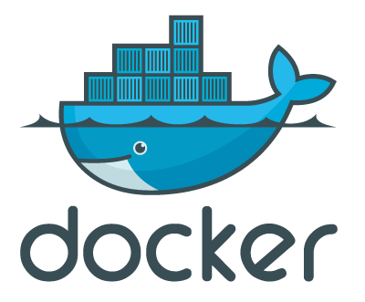
What is docker
Docker is a software platform for building applications based on containers — small and lightweight execution environments that make shared use of the operating system kernel but otherwise run in isolation from one another. While containers as a concept have been around for some time, Docker, an open source project launched in 2013, helped popularize the technology, and has helped drive the trend towards containerization and microservices in software development that has come to be known as cloud-native development.

Slide 4
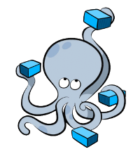
What is docker compose
Docker Compose is a tool for running multi-container applications on Docker defined using the Compose file format. A Compose file is used to define how the one or more containers that make up your application are configured. Once you have a Compose file, you can create and start your application with a single command: docker-compose up.

Slide 5
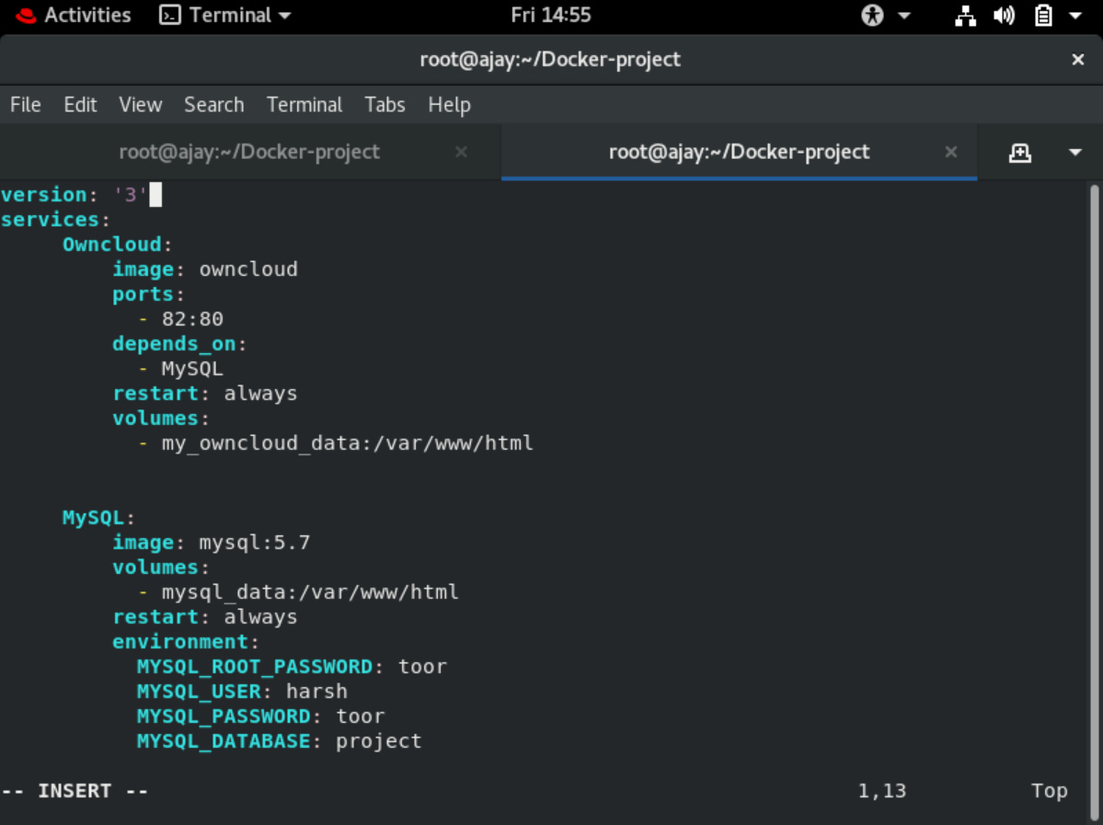
Working of project Creating docker compose file

Slide 6
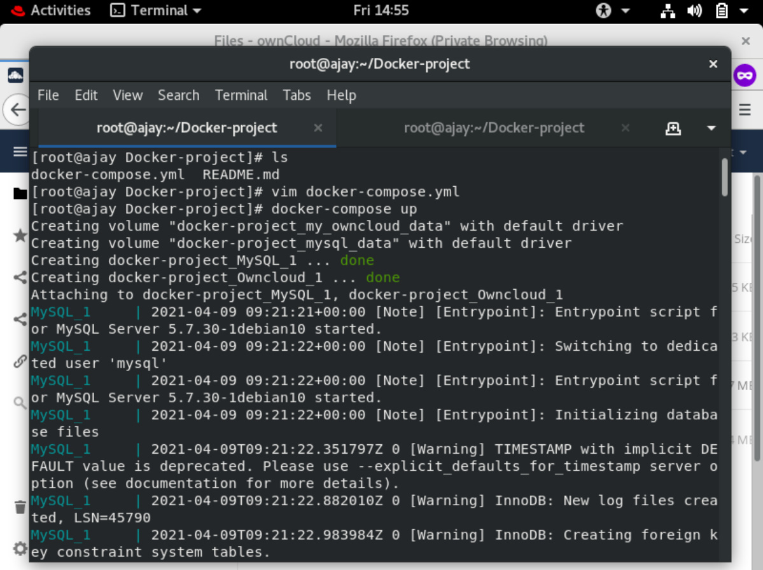
Running docker compose file

Slide 7
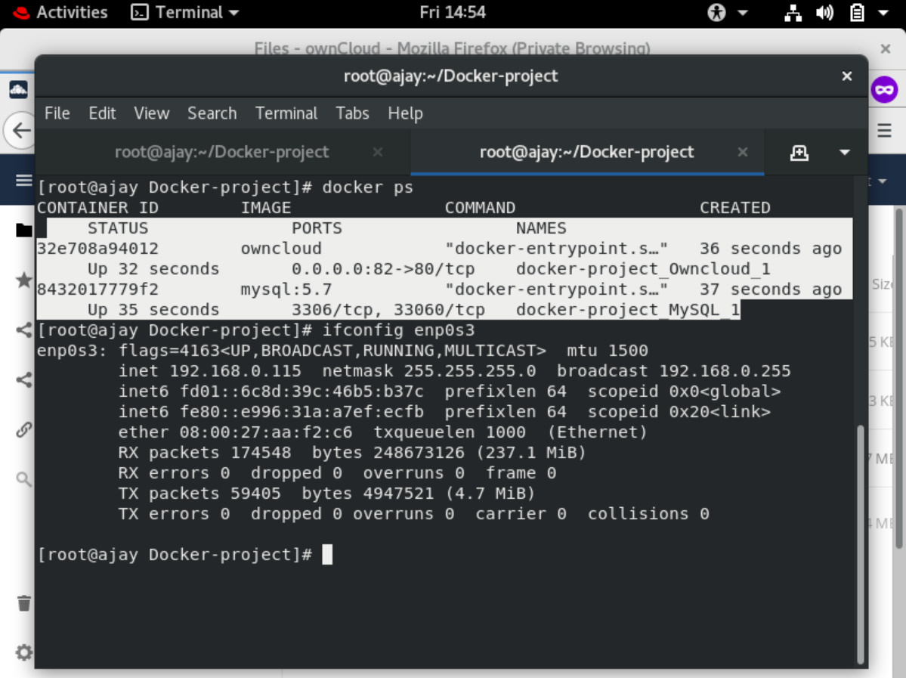
Docker containers runs successfully

Slide 8
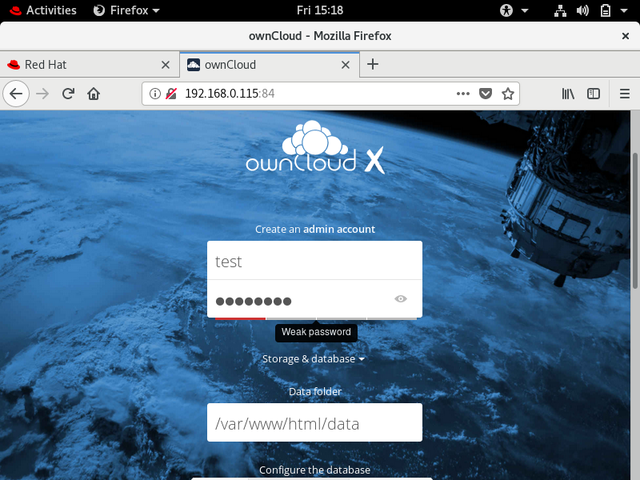
Accessing owncloud in browser

Slide 9
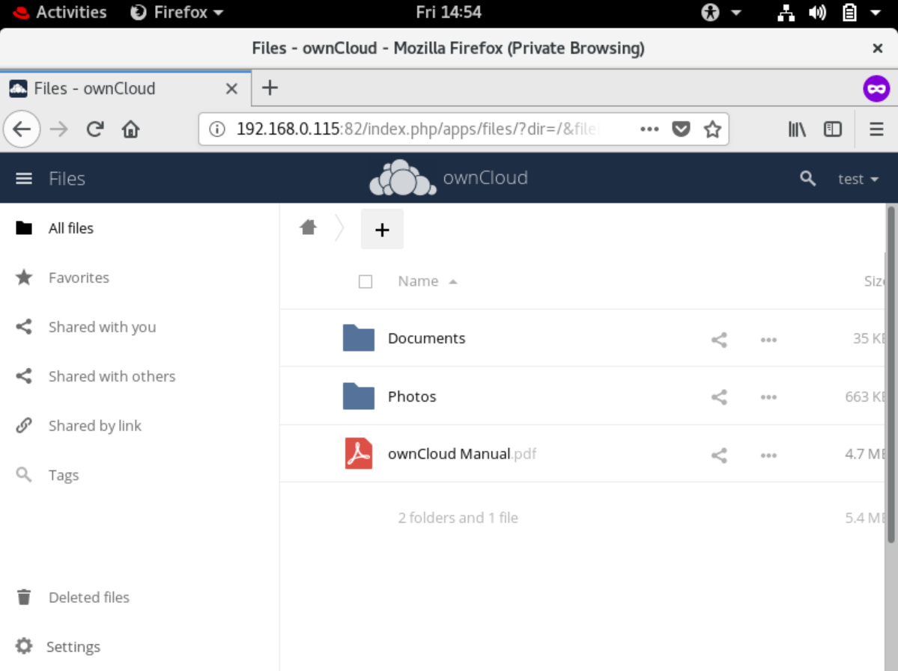

Slide 10
Video demonstartion link
https://drive.google.com/file/d/1_JW23ufYx0fFB01YDPd2wxZfAp9QDBAr/view?usp=sharing

